Slide 1
Team 5
Team 5
IT Application Project

Slide 2

Company
The National Environmental Agency (NEA)
Team 5
IT Application Project

Slide 3
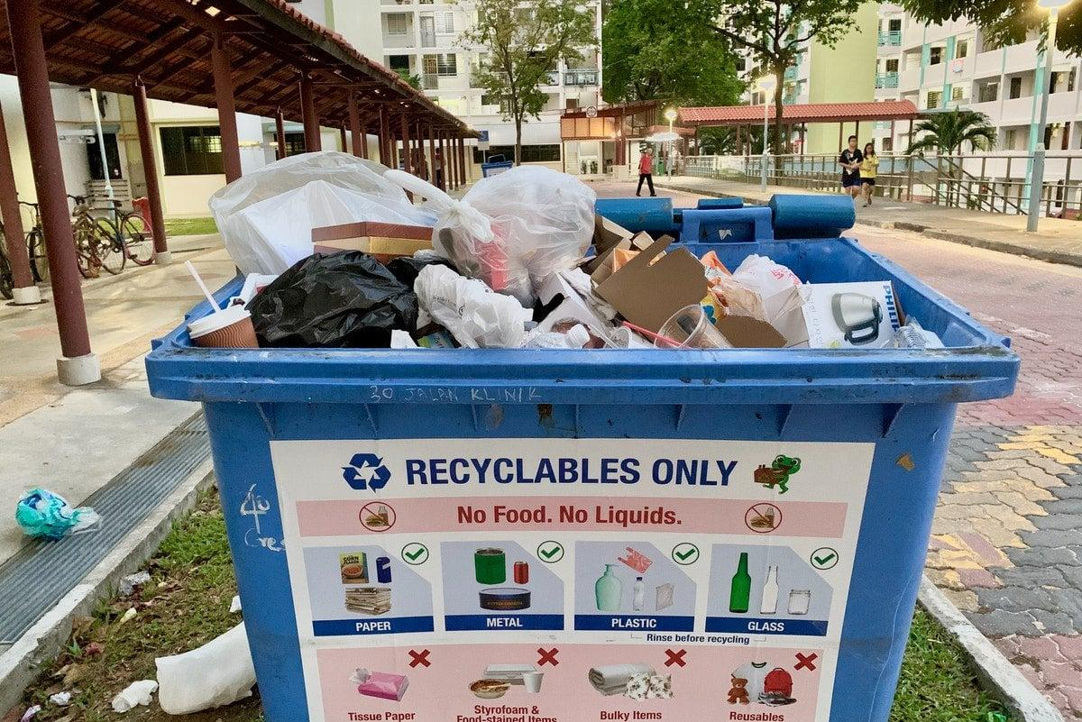
Challenge
The National Environmental Agency has difficulties in recycling because of cross-contamination.
Team 5
IT Application Project

Slide 4
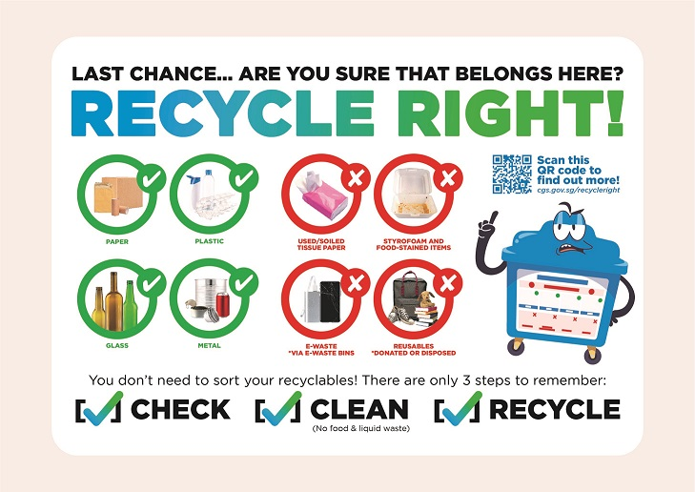
Background
About 40% of waste that goes into the recycling bins cannot be recycled, as they are either not recyclable or are contaminated by food or liquids.
Team 5
IT Application Project

Slide 5
Solution
Educate Singaporeans on how to recycle right by making a Recycling sorter game
Team 5
IT Application Project

Slide 6
Menu
Objective:
The start screen of the project.
Allows users to enter
Change settings
Faril
IT Application Project

Slide 7

Start Menu
Wireframe:
Has a play button → when clicked moves the user into the home page.
Has a cog wheel → when clicked moves the user into the setting page.
Faril
IT Application Project

Slide 8
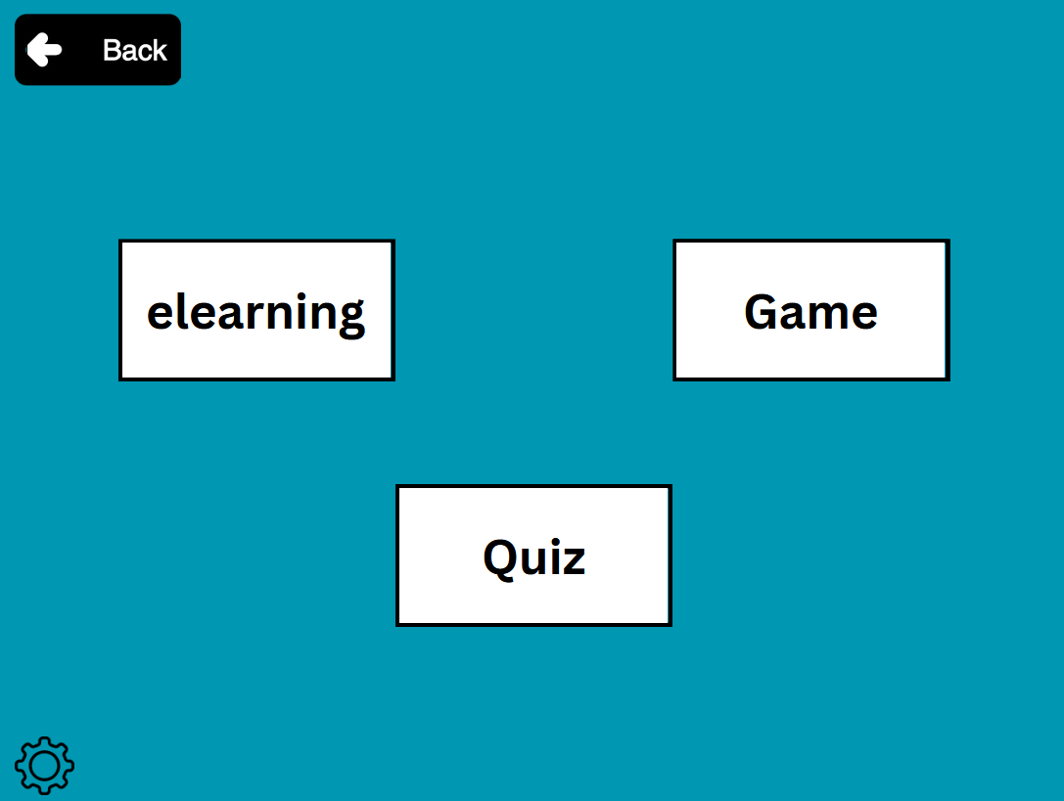
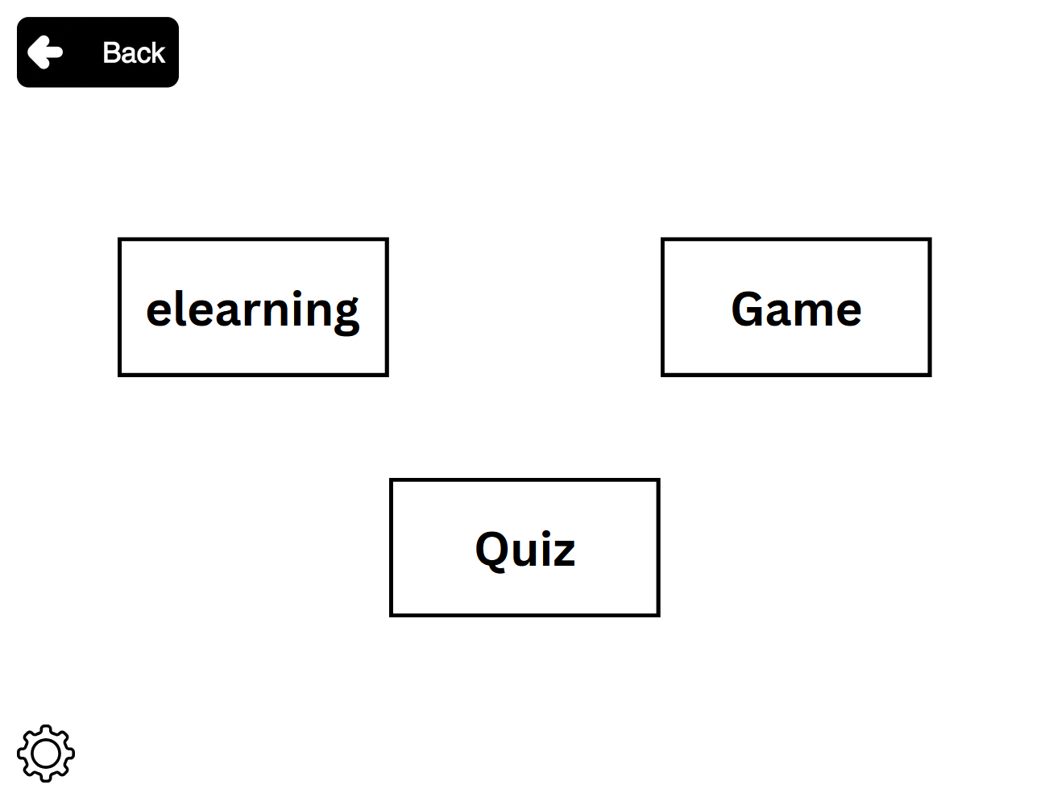
Home page
Wireframe:
Has a back button → when clicked moves the user back to the previous page.
Has a cog wheel → when clicked moves the user into the setting page.
Has a elearning button → when clicked moves the user into the elearning page
Has a game button → when clicked moves the user into the start page of the Game.
Has a Quiz button → when clicked moves the user into the start page of the Quiz.
Faril
IT Application Project

Slide 9
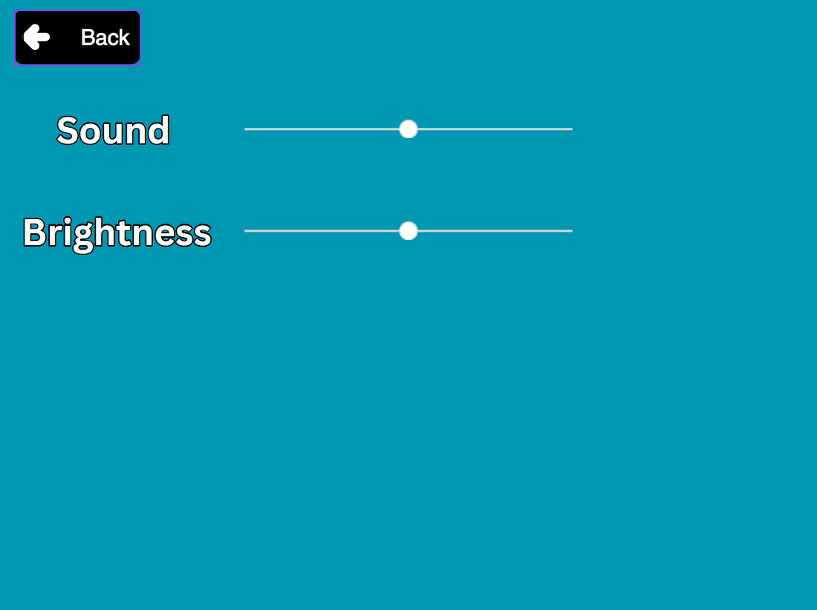
Settings
Wireframe:
Has a back button → when clicked moves the user back to the previous page.
Has a sound slider → when moved changes how loud sound is
Has a brightness slider → when moved changes how bright it is
Faril
IT Application Project

Slide 10
E-Learning
Objective:
Informs users on proper recycling
Prepares for the quiz and game
Faril
IT Application Project

Slide 11
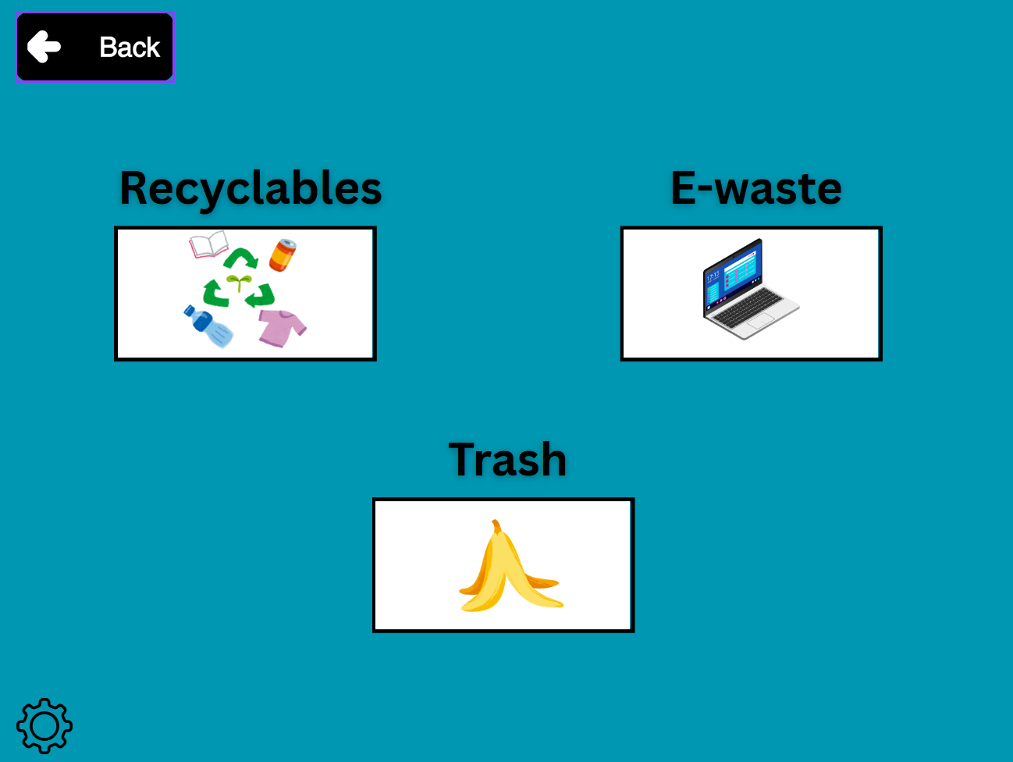
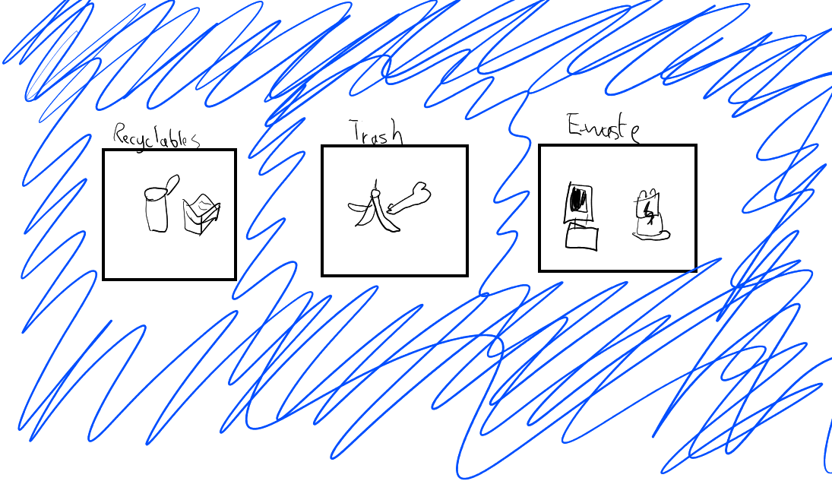
E-Learning
Insert wireframe here
Has a back button → when clicked moves the user back to the previous page.
Has a cog wheel → when clicked moves the user into the setting page.
Has a 3 buttons, which when pressed brings the to what they are.
Back
IT Application Project

Slide 12
Game
Objective:
To help make information easier to remember by presenting it in a game format.
A high score mechanic will be implemented to encourage users to try and beat the current high score holder.
It allows for players to easily demonstrate their understanding of the information provided in the e-learning
Isaac / Caleb Roberts
IT Application Project

Slide 13
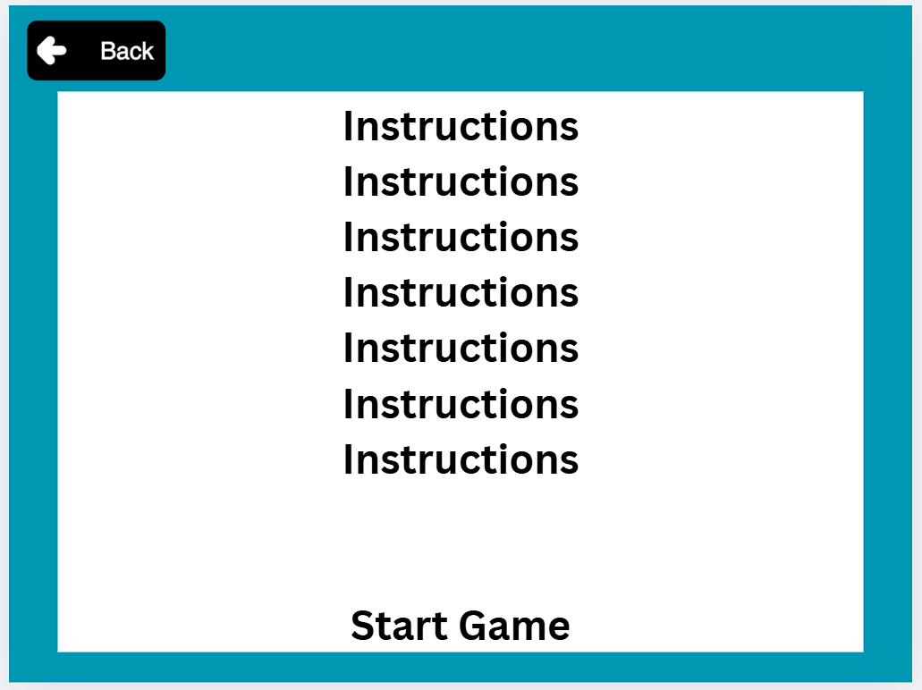
Game
Purpose
Brief the player on the game mechanics and start the game.
When the “Start Game” button is clicked, it starts the game.
Isaac / Caleb Roberts
IT Application Project

Slide 14
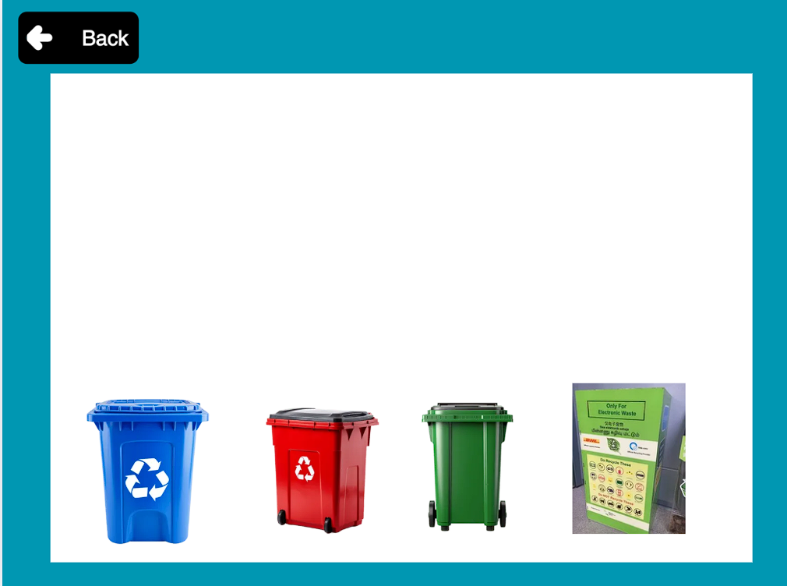
Game
Wireframe:
Game Mechanics:
Common waste items will drop from the edge of the play area
The player is tasked with sorting the items into each of the 5 bins correctly (paper, plastic, metals, e-waste, general waste)
If a contaminant (e.g., coffee, tea) is sorted into the recyclable bins, the score for that specific bin is reset to 0
The player has 3 lives, if an item is not sorted in time, the player will lose a life. Lose all 3 lives and the game ends.
Isaac / Caleb Roberts
IT Application Project

Slide 15
Quiz
Objective:
to test user knowledge on recycling after they completed the game and e-learning
A multiple choice quiz
To help test user memory on the right way of recycling
Include score to help users see whether they know their stuff
Archer
IT Application Project

Slide 16
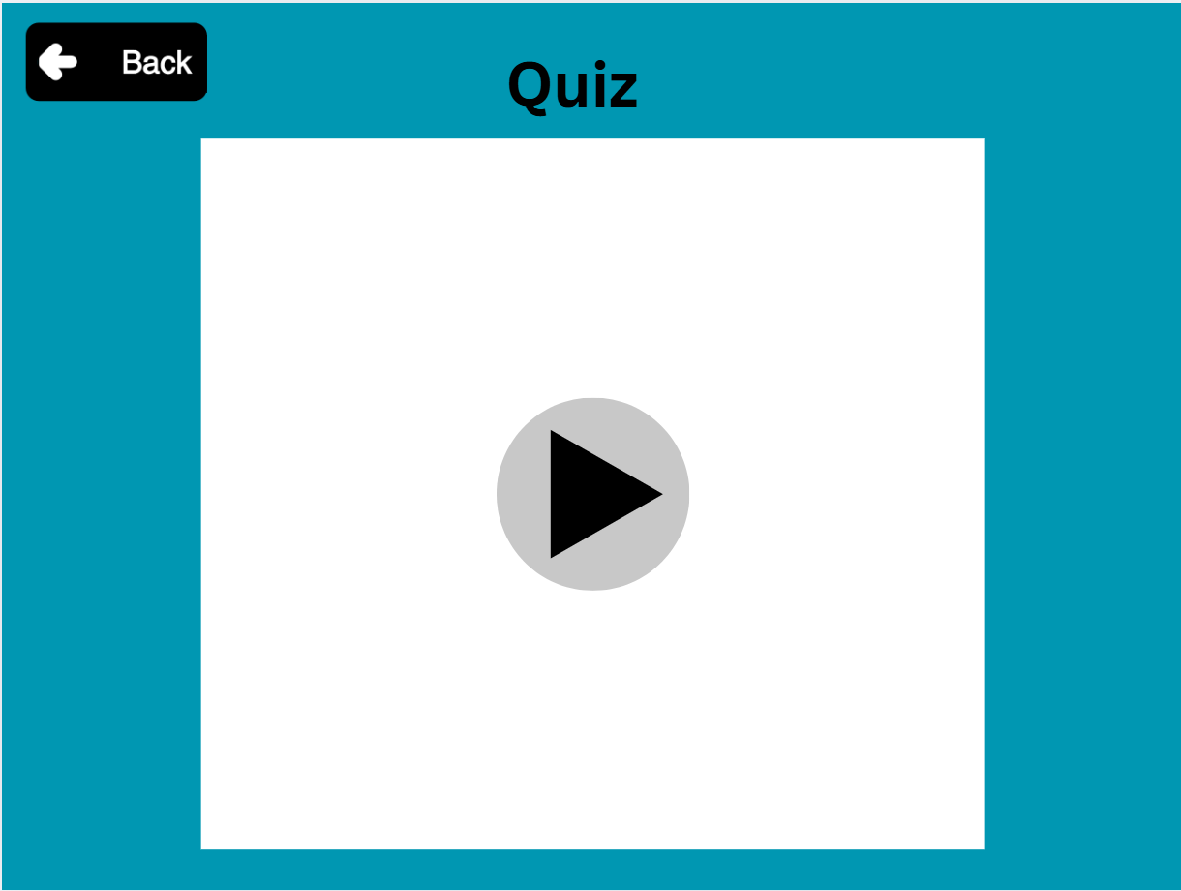
Start page for quiz
Wireframe:
Purpose: To start the Quiz
Things Included:
Start Button
Back Button
When start Button is clicked, move user to questions page.
Archer
IT Application Project

Slide 17
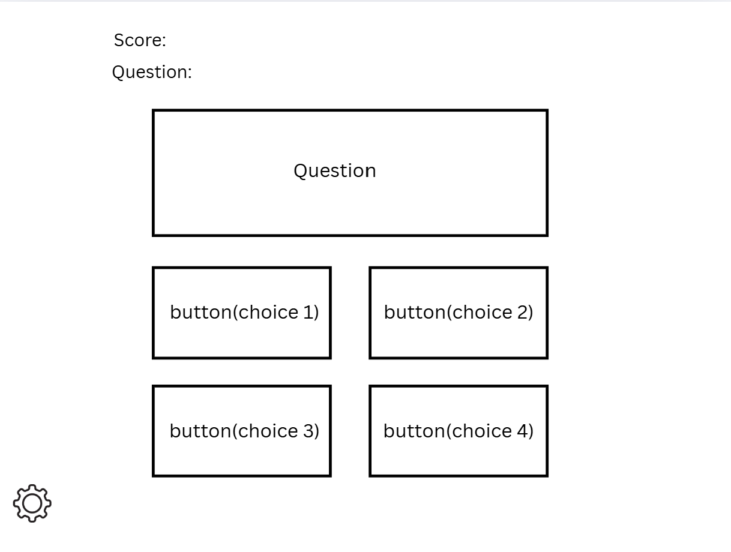
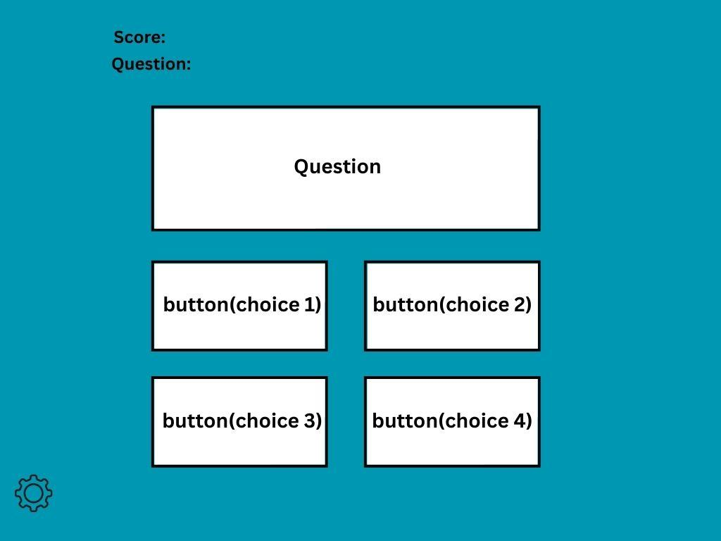
Questions page
Wireframe:
Purpose: To provide questions on recycling to test the knowledge of users.
Things included:
Score
Number of questions
The Questions
4 buttons with answers(only 1 correct answer per question)
Settings Button
When button is clicked move on to next question.
Score and no. of questions will change accordingly.

Slide 18
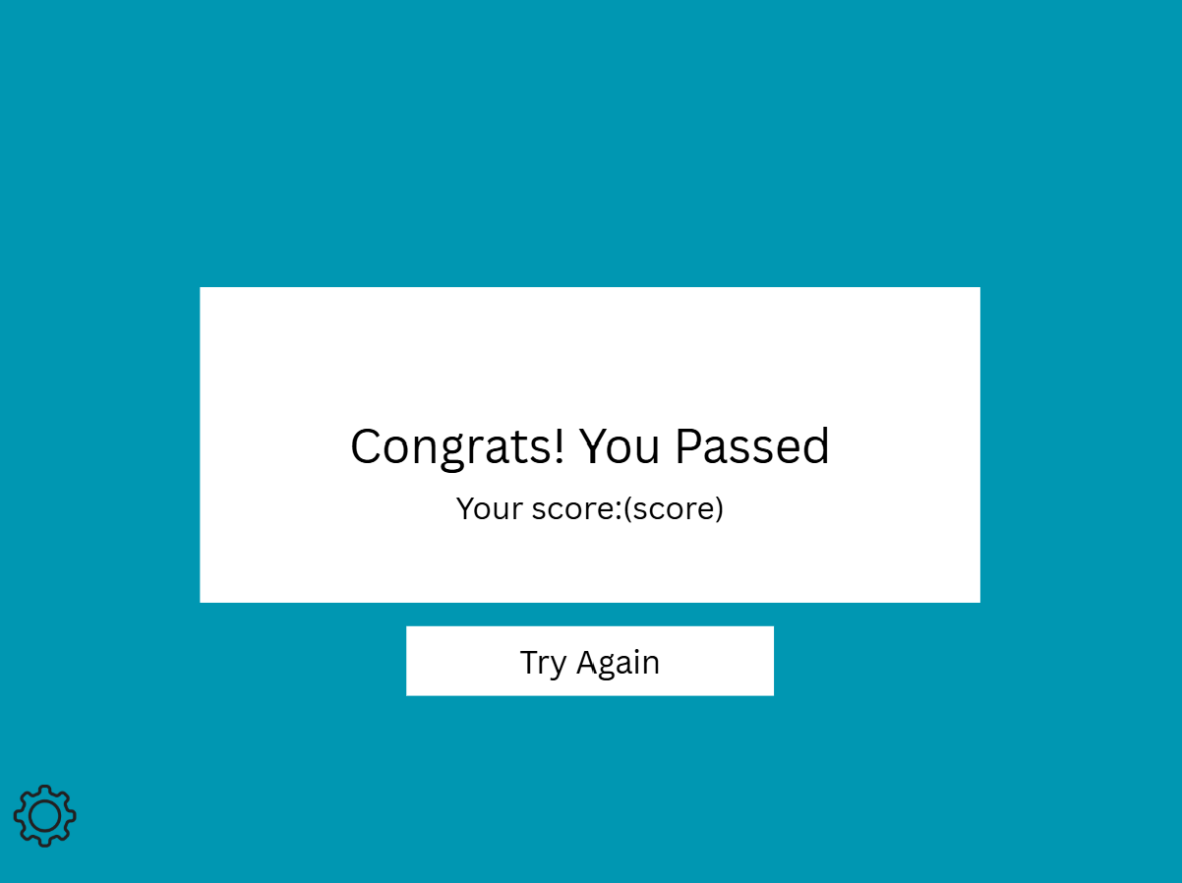
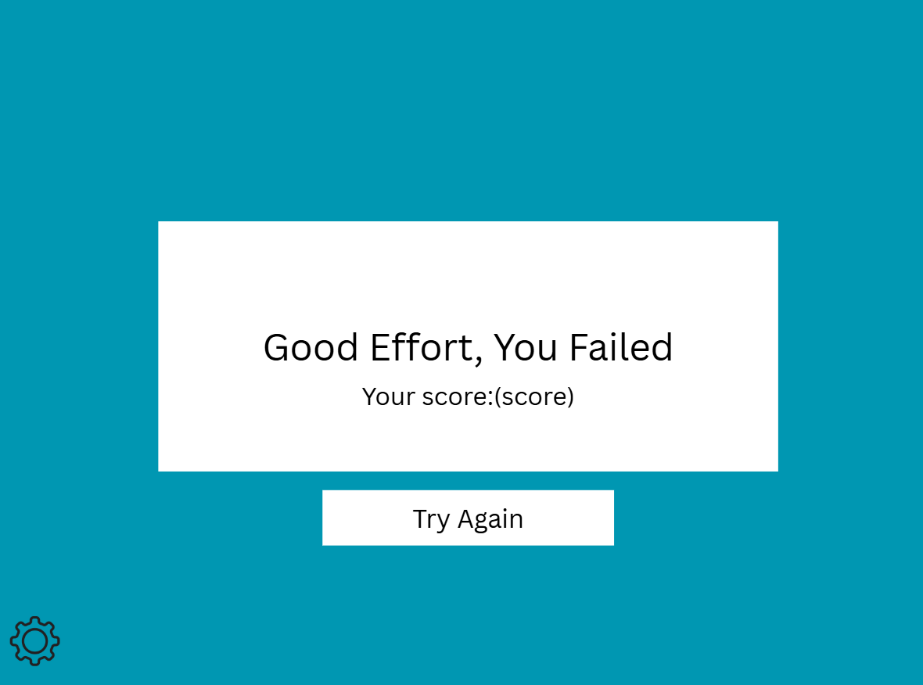
End Screen for Quiz
Pass(outcome):
Fail(outcome):
Wireframe:
Wireframe:
Purpose: indicate score and if user passed the Quiz
Include:
Settings Button
Try again button
Brings user back to the Quiz starting page
Purpose: indicate score and if user Failed the Quiz
Include:
Settings button
Try again button
Brings user back to the Quiz starting page

Slide 19
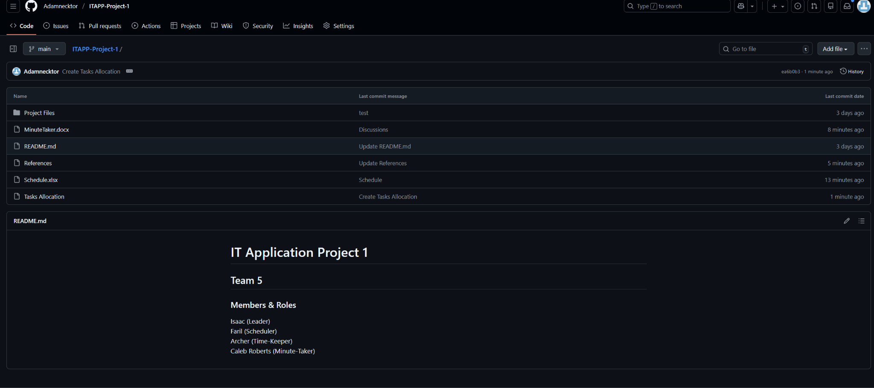
Github
https://github.com/Adamnecktor/ITAPP-Project-1/tree/main

Slide 20
Conclusion
Team 5
IT Application Project

Slide 21
REFERENCES
https://www.nea.gov.sg/media/readers-letters/index/nea-will-continue-to-work-with-stakeholders-to-put-out-consistent-recycling-messages
https://cnalifestyle.channelnewsasia.com/singapore/waste-generated-2021-recycling-nea-blue-bin-358581
https://rawicko.com/2023/07/07/recycling-in-singapore-what-you-need-to-know/
Team 5
IT Application Project

